Slide 1
Neural microcolumns as transmission lines
Vincent Baker
Drexel University Department of Physics

Slide 2
Hypothesis
1-D neural microcolumn structures can exhibit traveling waves, synchronized firing activity that propagates along the microcolumn
Microcolumns could provide an effective means to transfer information between regions of the cortex
The local connectivity of the microcolumn provides specificity in the source and target sites
The all-or-nothing response of the traveling waves encodes sparse source information (i.e. average firing rate) into strong synchronized events
Microcolumns

Slide 3
Methods – Neural Circuit
Simulation constructed from a pool of input neurons, a microcolumn (or microcolumn ensemble) as transmission line, and a pool of target neurons
asdasdasd
Input neurons randomly connected to input layer of transmission line
Output layer of transmission line fully connected to output neurons
Transmission line
Input neurons
Output neurons

Slide 4
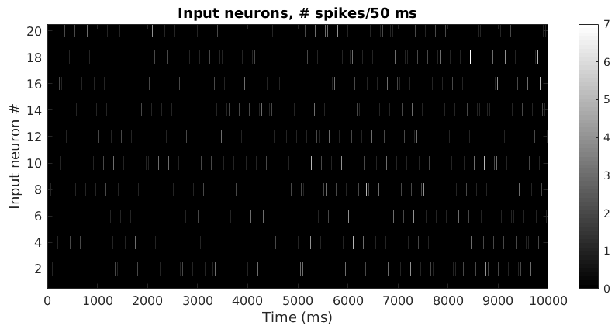
Methods - Input
Neurons in input pool fire at a specified firing rate, Poisson spike trains
Input pool randomly connected to transmission line with probability Pc
This input pool of 20 neurons all fire with an average spike rate of 15 spikes/second for the first 5000 ms, then with an average rate of 30 spikes/second for the second 5000 ms. The colors indicate the number of spikes emitted by that neuron in a 50 ms window.
15 spikes/second
30 spikes/second

Slide 5
Methods – Transmission Line
Either a single microcolumn or an ensemble of microcolumns

Slide 6
Methods - Observations
Correlation between firing rate of input pool (Poisson spike trains) and output response
Correlation between input synchronization and output response
Reliable transport of an input “event”

Slide 7
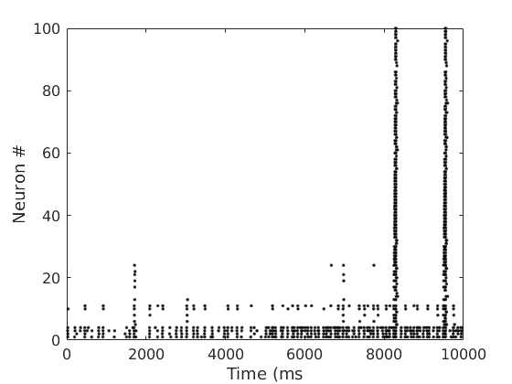
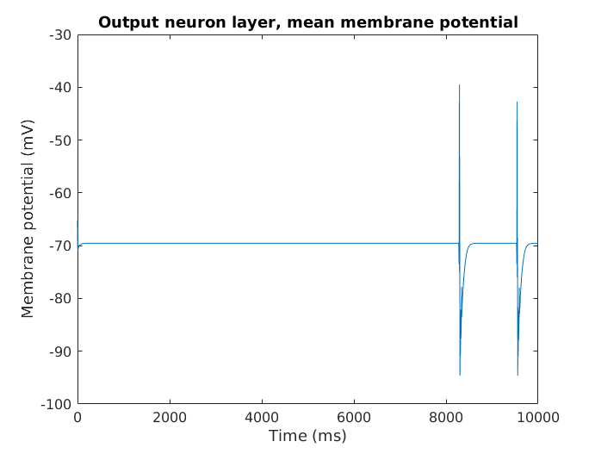
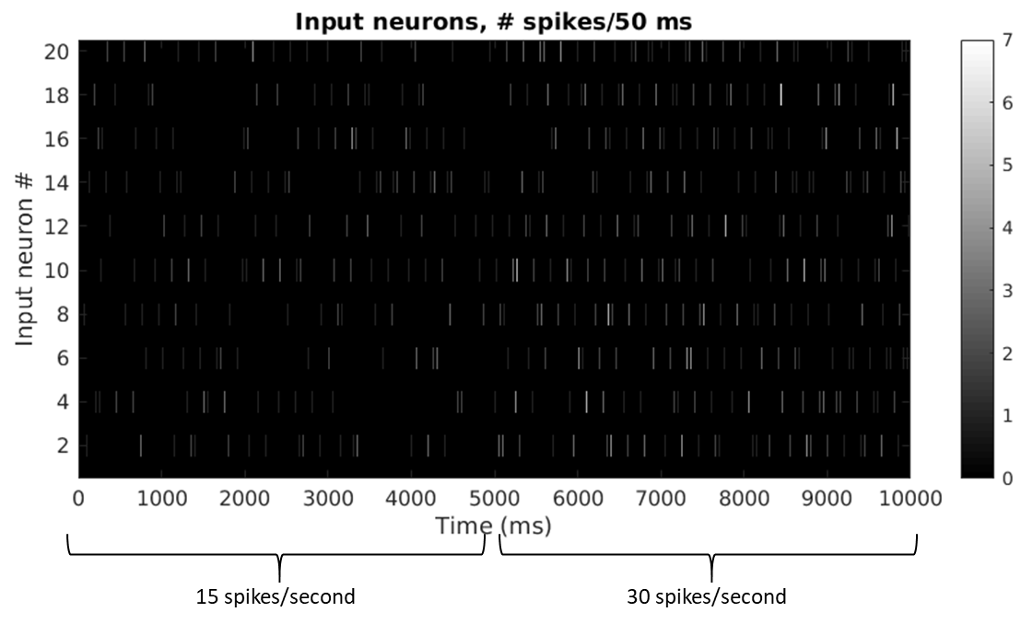
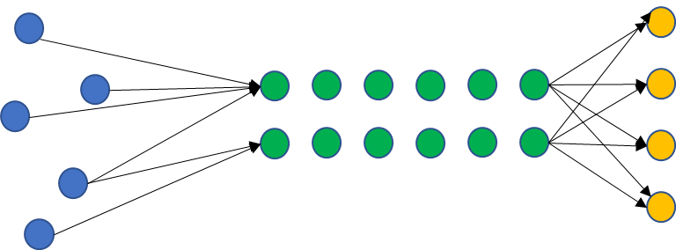
Example – 1 Microcolumn
Transmission line firing events
Input pool firing events
Pc = 50%
2x2x25 microcolumn

Slide 8
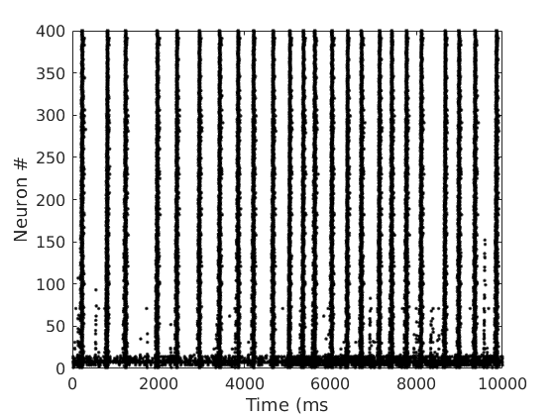
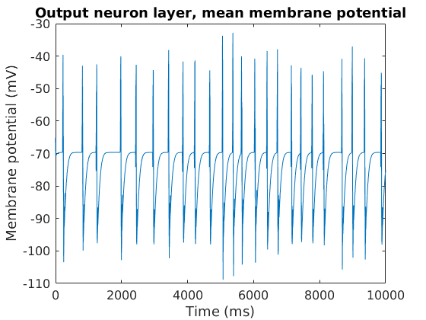
Example – Ensemble, closely spaced
Transmission line firing events
Input pool firing events
Pc = 50%
4-column ensemble
Spacing 7 between columns

Slide 9
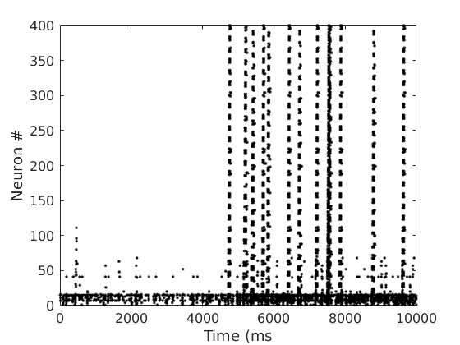
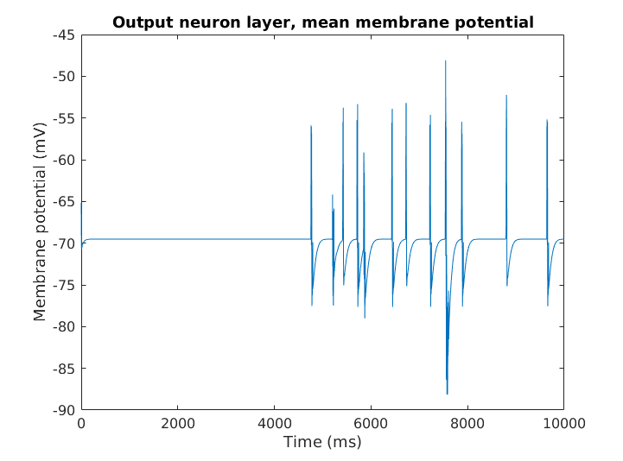
Example – Ensemble, widely spaced
Transmission line firing events
Input pool firing events
Pc = 50%
4-column ensemble
Spacing 20 between columns

Slide 10
Next steps

